Slide 1
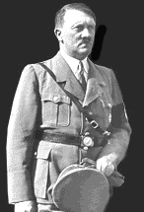

Adolf Hitler
Rise to Power

Slide 2
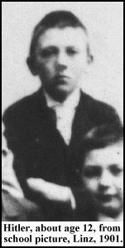
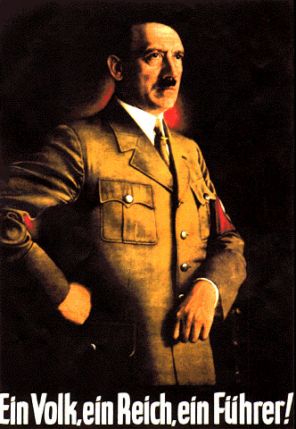
The Question.
How did the little boy on the left became the man on the right who was ultimately responsible for the death of about 50 million people all over the world?

Slide 3
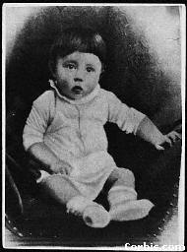
Birth
Adolf Hitler was born on April 20, 1889 in Braunau, Austria.
Adolf was 1 of 6 children - 3 of who died at early ages

Slide 4
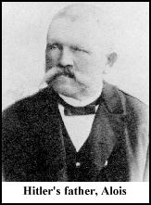
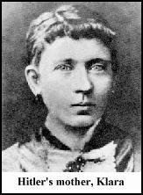
Parents
Alois Schickelgruber Hitler was a customs official who was illegitimate by birth. His father, Adolf’s grandfather, may have been Jewish. He died when Adolf was 14 and left him a small inheritance.
Klara Hitler was very young when she married the older Alois. She showered young Adolf with love and affection. Adolf carried a picture of his mother until the day he died. She died of breast cancer when Adolf was 18 years old.

Slide 5
Education
Attended a Benedictine monastery school where he took part in the choir.
When it was time to choose a secondary school, Adolf wanted to become an artist.
His father wanted him to become a civil servant, but after his father died, he dropped out of high school and attempted to get into the Vienna Academy of Fine Arts - he failed.
The following slides are examples of Adolf’s artwork.

Slide 6
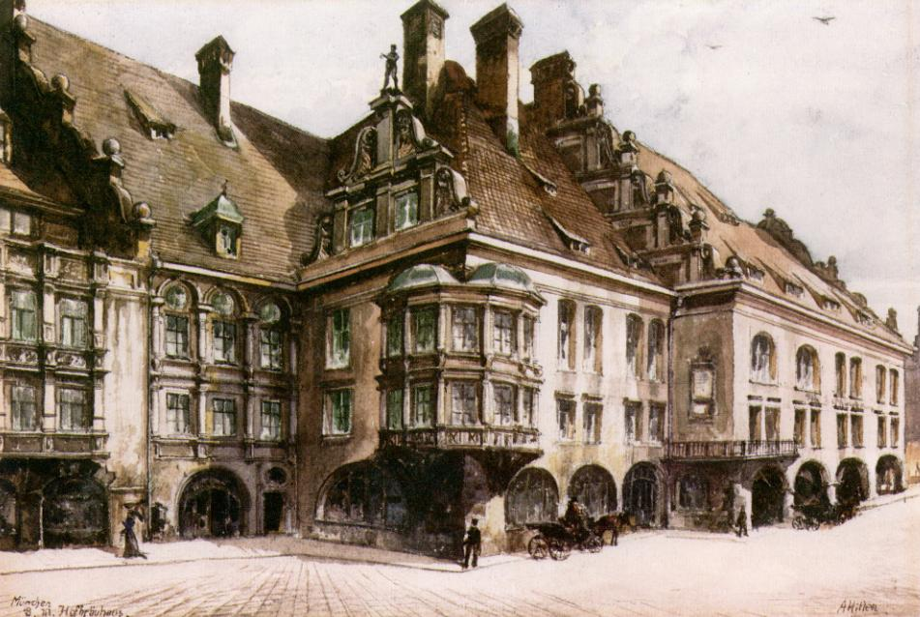
signature

Slide 7
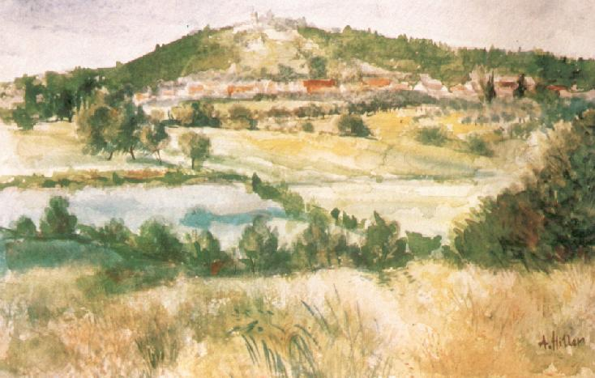
signature

Slide 8
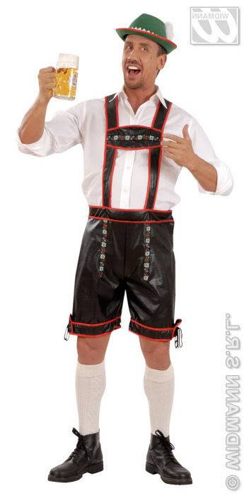
Years in Vienna
After his mother died, Adolf (now 18) decided to move to Austria to pursue his dream of becoming a great artist.
Again he failed to gain entrance into the Academy
He eventually sold all his possessions and became a homeless drifter who slept on park benches and ate at soup kitchens throughout Vienna (age 19)
Adolf did manage to sell some paintings and postcards, but remained impoverished

Slide 9
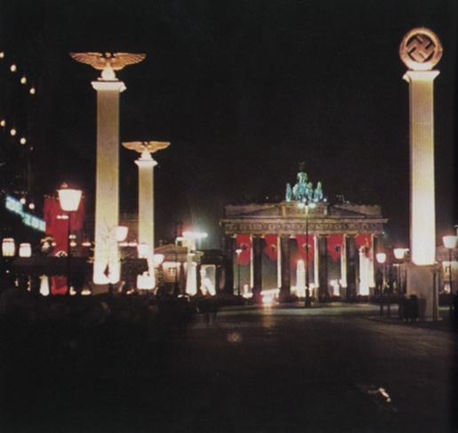
Vienna -Importance
Influenced by the anti-Semitic mayor of Vienna, Karl Lueger
Became interested in the idea of German nationalism.
Also received first taste of politics

Slide 10
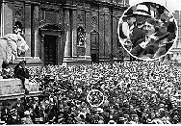
Military Service
Adolf left Austria at the age of 24 to avoid mandatory military service that was required of all men.
But he did sign up for military service at the start of WW I. He joined a Bavarian unit of the German Army. This is a picture of Hitler listening to an enlistment speech.

Slide 11
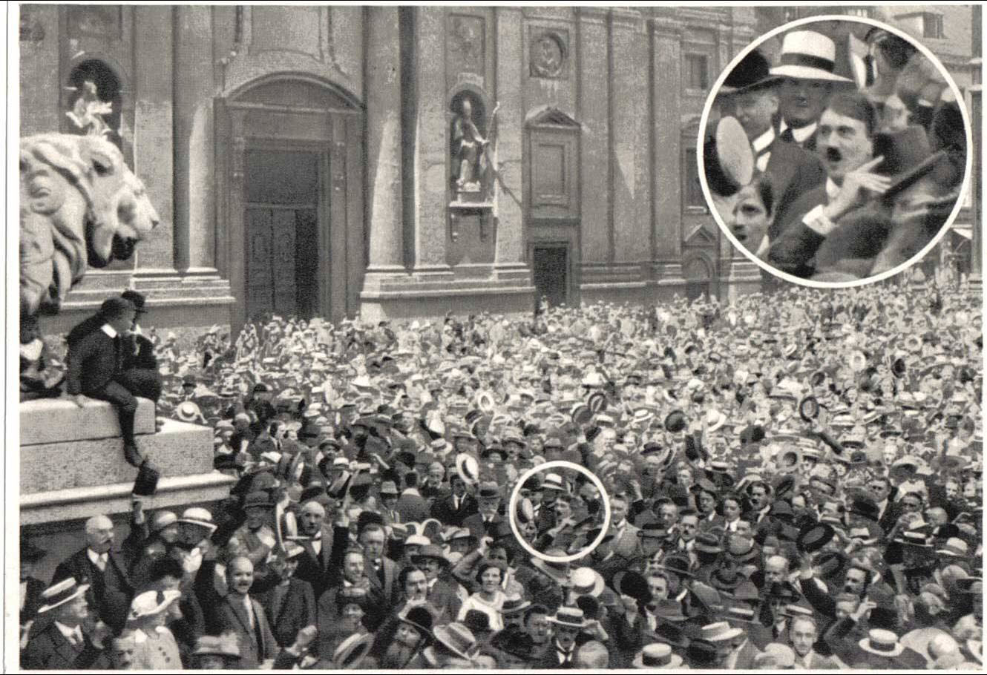

Slide 12
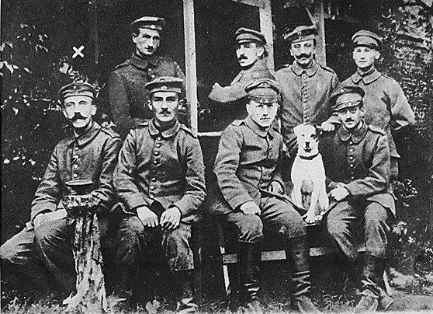
World War I
Excited to fight for Germany.
Found a home fighting for the Fatherland.
Highest rank held was corporal.
Was a regimental messenger, not an easy job at all.

Slide 13
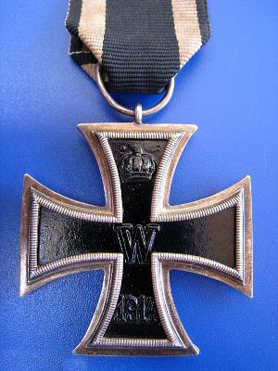
Military Record
Was awarded the Iron Cross twice. (5 medals overall)
Highest military honor in German Army.
Single handedly captured 4 French soldiers.
Blinded by gas attack towards end of war.

Slide 14
German Loss in WW I
Hitler was devastated when he heard the news of the German surrender.
He was appalled at the anti-war sentiment among the German civilians.
Believed there was an anti-war conspiracy that involved the Jews and Communists.
Also, felt that the German military did not lose the war, but that the politicians (mostly Jews) at home were responsible for the defeat.

Slide 15
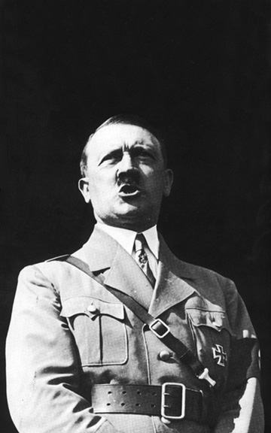
Life after WW I
Hitler was depressed after WW I.
Still in the army, he became an undercover agent whose job was to root out Communists.
Also, lectured about the dangers of Communism and Jews

Slide 16
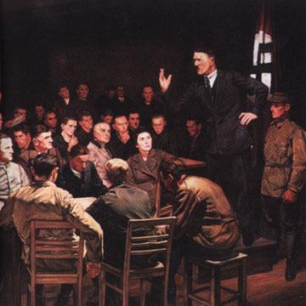
German Worker’s Party
Hitler was sent to investigate this group in Munich in 1919.
He went to a meeting and gave a speech.
He was them asked to become a member, which he did

Slide 17
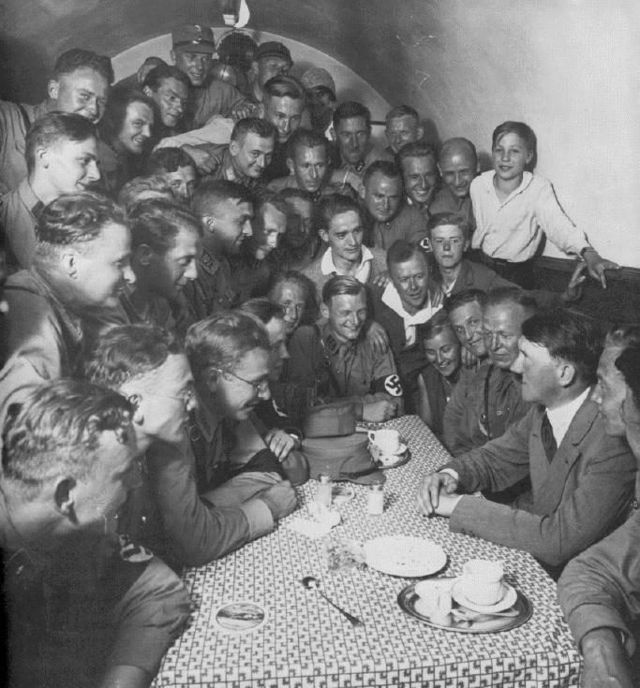
NAZI Party is Formed
Hitler began to think big for the German Worker’s Party
Began placing ads for meetings in anti-Semitic newspapers
Hitler changed the name to National Socialist German Worker’s Party or the NAZIS

Slide 18
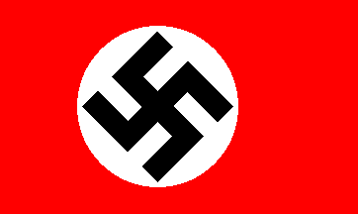
Party Platform
Hitler drafted a platform of 25 points
Revoke Versailles Treaty
Revoke civil rights of Jews
Confiscate any war profits
Besides changing the party name, the red flag with the SWASTIKA was adopted as the party symbol

Slide 19
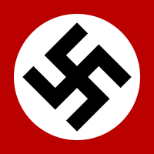




The Swastika
The swastika was an ancient symbol usually associated with the sun. It is still commonly used in Buddhist shrines.
Due to incorrect translations in Sanskrit/German dictionaries Hitler believed that the swastika was a symbol that represented the word Swasie which meant Aryan. This was not the case.

Slide 20
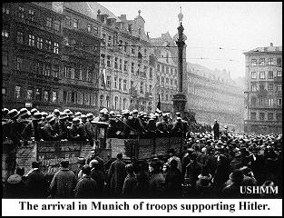
Beer Hall Putsch
October 30, 1923
Hitler held a rally in Munich beer hall and declared revolution
Led 2000 men in take over of Bavarian Government
It failed and Hitler was imprisoned

Slide 21
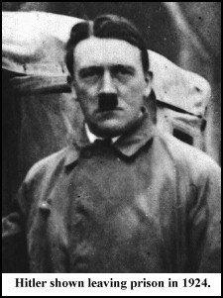
Trial and Jail
At his trial (Hitler was charged with treason), he used the opportunity to speak about the NAZI platform and spread his popularity.
The whole nation suddenly knew who Adolf Hitler was and what he stood for
He was sentenced to five years, but actually only served about 9 months
When he left prison, he was ready to go into action again.

Slide 22

Mein Kampf
Hitler’s book “My Struggle” - wrote while in jail
Sold 5 million copies, made him rich
Topics included: Jews were evil, Germans were superior race, Fuhrer principal, dislike of Communism and Democracy and need to conquer Russia

Slide 23
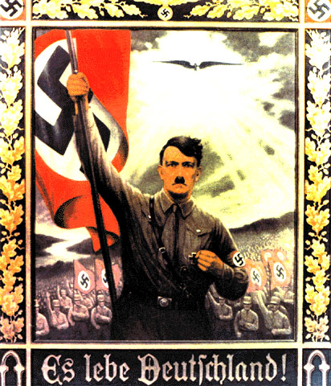
Legal Rise to Power
Used popularity from failed revolution and book to seize power legally
Spoke to mass audiences about making Germany a great nation again
Nazi Party:
  1930 = 18% of vote
  1932 = 30% of vote
  Hitler becomes Chancellor in 1933

Slide 24
Appeal of Hitler
Germany was in the midst of an economic depression with hyper-inflation
Hitler was a WW I hero who talked about bringing glory back to the “Fatherland”
He promised the rich industrialists that he would end any communist threat in Germany
Constantly blamed Jews for Germany’s problems, not the German people.
Hitler was an excellent public speaker.

Slide 25
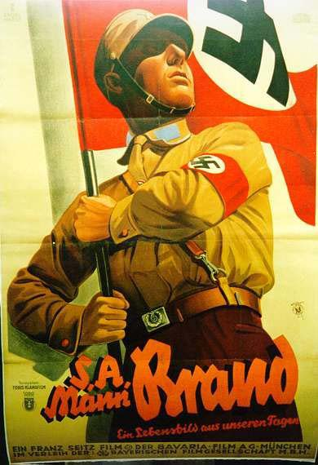
Strong Arm Tactics
The “Brownshirts” or SA (Stormtroopers)
SA was used to put down opposition parties
Threatened and beat up Jews and ant-Nazi voters
Wore brownshirts, pants and boots
Numbered almost 400,000 by 1932

Slide 26
Dictator
In 1933, all parties were outlawed except the Nazi party
People’s civil rights were suspended

Slide 27
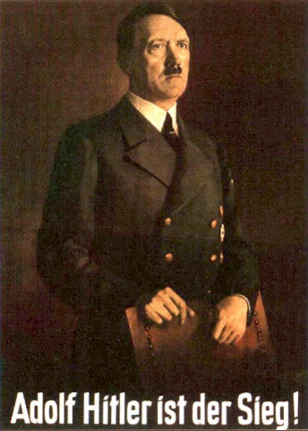
Absolute Power
German economy was improving, people were happy
Hilter had no political opposition
1st concentration camp opened in 1933
Began rearming German Army for expansion of the Reich

